Slide 1

Practical Arduino
From the Ground Up

Slide 2
Potential Course Outline (assumes no Prior electronics or Arduino knowledge)
Review Design Objectives. What you will learn. What you will need. Primer on Components and Symbols. Conductors, Insulators and Ohms Law. Introduce the kit and the included parts and how to obtain one.
Schematic vs PCB. Start it simple. Work up to this design complete walkthrough. (parts orientation, details, tips and tricks, how to solder, assemble board.) Build up the power supply portion the board. How to test your work with visual inspection and basic electrical testing.
Finish the build. Introduce The Arduino IDE. Use of in built test programs like Blink, Servo etc
More on Arduino IDE and simple program design. Use of serial monitor for debugging. Examples of practical use (Each as a standalone short video)
LED outputs (timing and random light)
Button Inputs (debouncing and controlling program flow)
Infrared detectors (sensor needed)
LDR sensors (LDR needed)
Motor Control (Motor Shield needed)
LCD displays (LCD display needed)

Slide 3
General Requirements
Basis:
An Arduino based hardware and software project that will serve as a learning platform
Finished product would be very useful in a variety of situations on any layout.
Ideally ordered as a complete kit. (PCB, all components, including Arduino NANO (clone))
Detailed instructions suitable for novices. Broken down as ‘build’, ‘test’, ‘learn’.
A series of videos can be made for self paced learning (able to pause, go back, review and check)
PCB design should be flexible in that I/O can be reconfigured without too much fuss. (for example taking the LED’s off board)
No expectation of ‘live sessions’ other than maybe introducing the kit once it is available
Feature List:
Socketable NANO on a carrier board.
Carrier board itself to have mounting holes.
Flexible input power (AC/DC/DCC)
On board regulation to 12 (5Vdc) at NANO Vin (See later comments )
NANO itself produces the 5 VDC for sensors and servos
Header pins aligned with standard servo pinout
On board output driver chip can power small relays or actuators.
On board R680 current limiting resistors
2 board mounted Pushbuttons as DI’s
Prototype test area.
Bring out all unused digital and analog I/O
A dedicated header for I2C using A4/A5/+5 and Gnd
4 LED on board via R680
AC/DC or DCC powered
DCC signal via optocoupler
2 SERVO via 3pin Header
ULN2803A Output Driver
NANO V3 MCU
2 Buttons on board
Spare I/O
4 Sensors via 3 pin header
I2C via A4/A5
Carrier Board

Slide 4
Introducing: MERGduino
Coming Soon

Slide 5
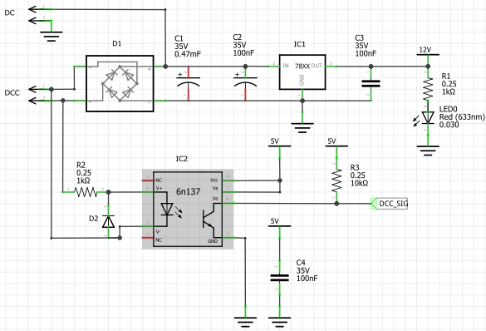
MERGduino: Power Supply
Feature List (Power):
Flexible input power (AC / DCC or DC)
On board regulation to 12 vdc at NANO Vin
(Or Regulated 5 vdc direct to Arduino)
Can be built standalone as a ‘power supply’ providing 12 volts.
Header pins to be provided on PCB for power take off.
On board LED for troubleshooting without NANO
Can learn to take measurements using DMM.
Feature List (DCC Opto-Coupler):
Optically couples DCC to Arduino Pin
Enables Arduino to act as a stationary Accessory decoder
Optional – Can omit if not needed. If it is used board must have an Arduino installed to provide the 5 volts for operation.

Slide 6
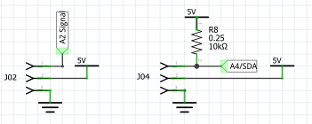

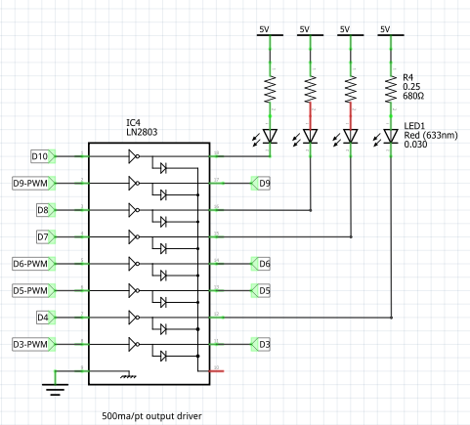
MERGduino: I/O
Top Left
Standard I/O header with pins in order (Signal, 5VDC, Gnd)
Suitable for AI, AO, DI, DO with or without internal pullup
Top Right
Standard I/O header but with optional pullup resistor
Pullup is needed in at least one place on a I2C bus
Can also be used for precision voltage divider experiments
Middle
On Board buttons for I/O testing
For use with internal pullup
Includes current limiting resistor in case the pin is accidentally configured for output and then the button is pushed
Bottom
Optional LN2903 output driver.
If not used jumpers can be installed directly across.
If included allows a sinking current of 500 ma per pin. Can power small relays, incandescent bulbs, light strips.
4 on board LED’s with current limiting resistors for experimenting.
PCB to have pin headers so that LED’s could be remote mounted as signals, building lighting, mimic panel
Unused pins to have connection points available

Slide 7
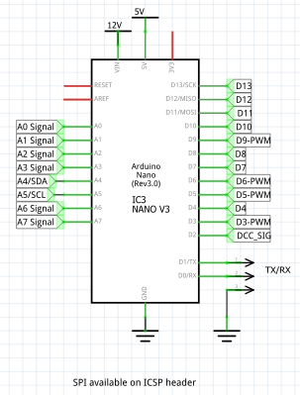

MERGduino: CPU
Standard NANO V3 Clone
To be mounted in header pins which are soldered onto the main board
optoisolator and other small components will be under the NANO
All I/O pins land somewhere and are available
PWM pins called out especially for use on SERVO’s or Motor control
I2C (SDA/SCL) have provision for pull up resistors otherwise same as standard analog pins
I2C brought out to 4 pin header for connection to servo expander
Tx/Rx available on 3 pin header
Still considering:
A row of holes where a DfPlayer ‘daughter board’ (MP3 sound effects) could be added.
A row of holes where a max485 ‘daughter board’ (CMRI interface) or general comm’s could be added.

Slide 8
MERGduino: Work Phases
All Projects go through phases (whether they are recognized as such or not)
Phase | Description | Conditions for Going Forward | Decision | When
0 | Idea | Someone is willing to work it | Yes – Alan | Dec 2021
1 | Definition | Requirements are set. | This is In Progress | Jan 2022
2 | Basic Design | Previous stage passed.
3 | Detailed Design | Previous stage passed.
4 | Execution | Previous stage passed.
5 | Commissioning | Previous stage passed.
6 | Closeout | Considered ‘done’ and ready for use.
Implied is that in all cases a phase can only happen if someone is willing to work that phase (Obviously some resources/effort will be needed). As MERG is a volunteer organization this could be an individual or a ‘working group’.

Slide 9
MERGduino: issues and outcomes
Item | Description | Reasons Why | Reasons Why NOT | Decision | When
0 | Use 5 VDC Power to Arduino instead of Vin | Using a 7805 gives more flexible input power options including standard 9 volt battery and 12 VDC. Offloads the NANO regulator | Reference design used a 7812
1 | Keep Line Driver IC | Allows higher current loads of independent voltages. Protects NANO | Cost in terms of PCB space Part cost (pennies)
2 | Choice of Current Limiting R value | R330 and R470 was traditional | New LED’s more efficient use R680 or even R1K | Do some Testing
3 | External I2C pullup | Allows control over I2C value Simple soldering job and use of DMM lessons. Ohms Law. | Could use internal pullups Save real estate and cost (pennies)
4 | Include MAX485 | General RS485 comms CMRI connectivity | Cost in terms of PCB space Part cost (pennies)
5 | Include MP3 dfPlayer | Sound Fx is a whole area of interest. | Cost in terms of PCB space Part cost (pennies)

Slide 10
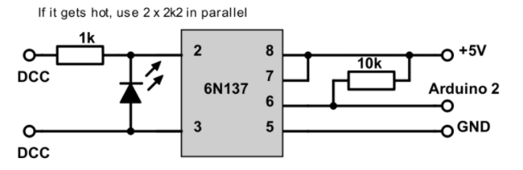
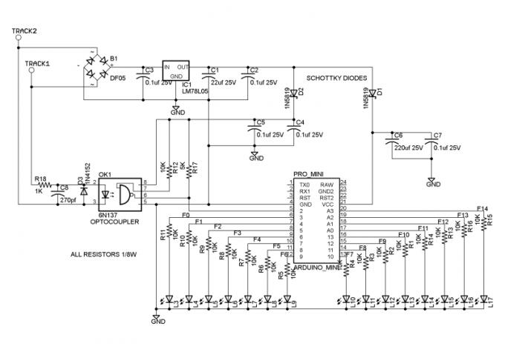
Links and Resources
https://rudysarduinoprojects.wordpress.com/2019/05/06/fun-with-arduino-29-dcc-accessory-decoder/
http://trainelectronics.com/DCC_Arduino/index.htm

